Slide 1
MODULE LAUNCH
Exercise Prescription for Special Populations
UZYKG9-15-3
Presentation by
Dr Rob Grieve

Slide 2
Main Aims
The aims of this module launch are:
Provide an overview of the content and purpose of the module.
Explain how the module content is split across the two courses.
Overview of teaching timetable between Wednesday 25th to Wednesday 1st April 2026.
Outline the module assessment.

Slide 3
Progression of Exercise Prescription
Level 2
Level 3
Foundations of Exercise Prescription
Applied Athlete Conditioning and Sport Nutrition
Exercise Prescription for Special Populations

Slide 4
This module is made up of two courses…although closely linked!
Progression from Foundations of Exercise Prescription.
Important to review the previous material covered and build on it in this module.
COURSE 1
Assessment and Clinical Reasoning Underpinning Exercise in Special Populations.
COURSE 2
Benefits, Prescription and Application of Exercise and Physical Activity to Special Populations.

Slide 5
Module Learning Outcomes/Goals
COURSE 1:Assessment and Clinical Reasoning Underpinning Exercise in Special Populations.
Apply appropriate skills and techniques in the physiological assessment of patients with selected controlled medical conditions in the context of exercise referral.
Evaluate the current evidence available to support exercise in special populations.
Course Content
Assessment adaption for special populations related to exercise.
Knowledge and understanding of the benefits of exercise and physical activity applied to special population groups.
Evidence based practice in clinical exercise.
Effect that leading a physically active lifestyle can have on health.

Slide 6
Module Learning Outcomes/Goals
COURSE 2:Benefits, Prescription and Application of Exercise and Physical Activity to Special Populations.
Apply the underpinning knowledge required to plan, design, adapt and review a scientific exercise prescription for selected controlled medical conditions.
Demonstrate a critical awareness of the dose response issues related to exercise prescription in selected controlled medical conditions.
Course Content
Application of knowledge and understanding of the benefits of exercise and physical activity applied to special population groups.
Principles of planning and designing exercise progammes for special populations – things to consider.
How exercise programmes can be adapted.
Evidence review of adaption of exercise for special population groups.

Slide 7
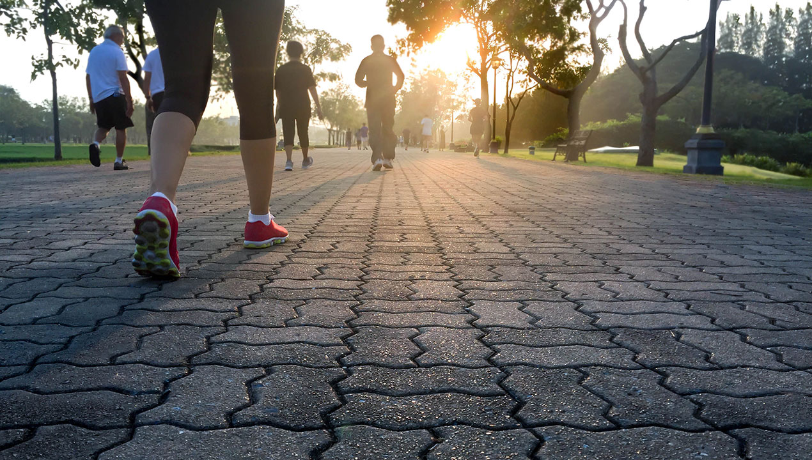
Is there much research in this area?
Which guidelines do we refer to for guidance related to PA and Health?
Have a chat with person next to you, why do you think this is important?
Why prescribe exercise for people with a medical condition?

Slide 8
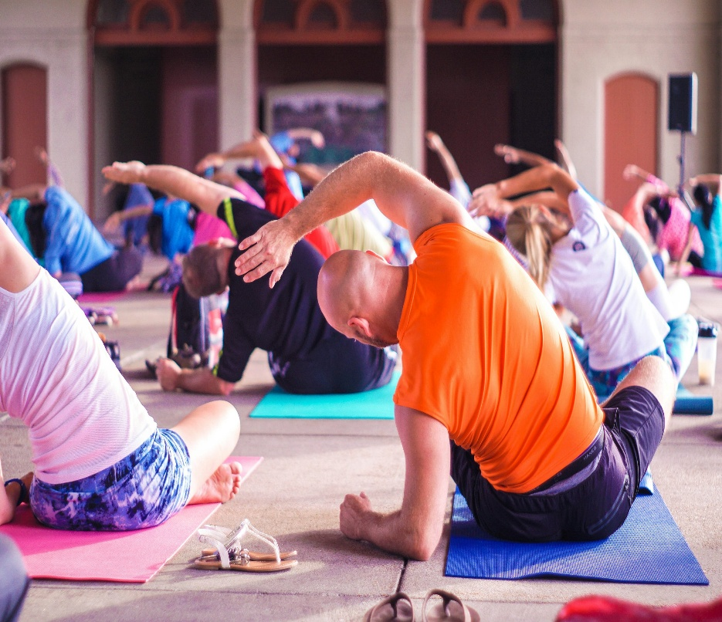
We will be covering the following medical conditions in relation to exercise prescription
Falls, mobility issues and frailty (elderly)
Obesity (all ages)
Arthritic conditions (incl msk pain)
Focus on OA (hip and knee)
Anupam Mahapatra-Unsplash

Slide 9
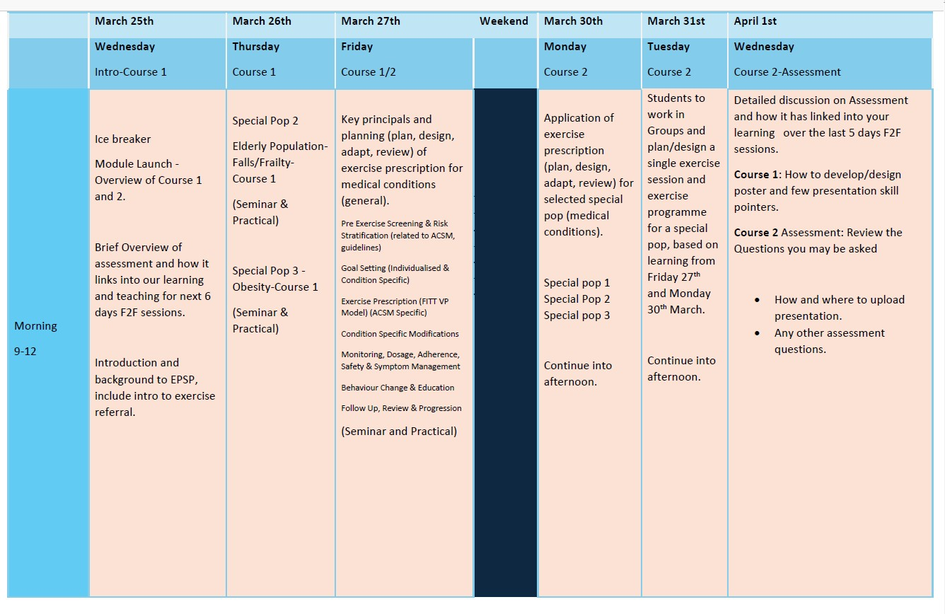
Timetable-Teaching and Learning at HMU Wed 25th March to Wed 1st April 2026.

Slide 10
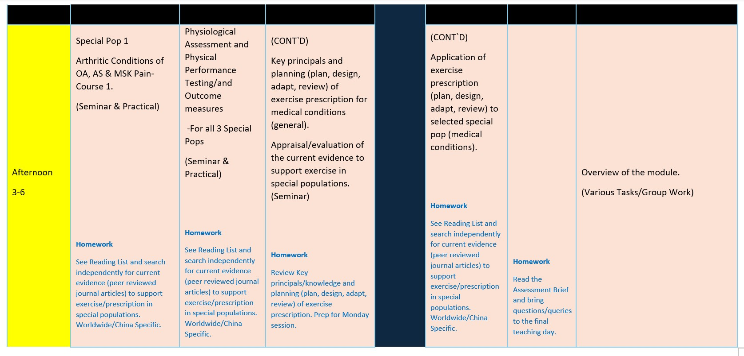

Slide 11

Module format
Teaching and learning will be a combination of online and in classroom including practical sessions.
Students will be expected to review resources, reading material related to the in-person teaching sessions.
Students will be encouraged to participate in the lecture material teaching as the tutor's approach is to facilitate learning.
This may a be a new learning approach to many of you but is central to the learning and teaching approach in this module.
Photo by Van Tay Media on Unsplash

Slide 12
Teaching
Approach
Phil Race:
How Students Really Learn ‘Ripples’ model of learning
Ripples on a pond….
Any thoughts on this approach to teaching
&
learning?
Wanting
Needing
Doing
Making sense
The Lecturer’s Toolkit
Phil Race
Routledge, London, 2015, 2025
Feedback
Verbalising
Assessing

Slide 13
Module Assessment Components
See assessment Brief on Bb
Must achieve minimum 40% in all two assessments to PASS
Course 1: Assessment and Clinical Reasoning Underpinning Exercise in Special Populations.
Poster development and 10 min presentation on Blackboard (focus on Learning Outcomes).
Apply appropriate skills and techniques in the physiological assessment of patients with selected controlled medical conditions in the context of exercise referral.
Evaluate the current evidence available to support exercise in special populations.
COURSE 2:Benefits, Prescription and Application of Exercise and Physical Activity to Special Populations.
Questions by assessors (10 mins), expanding on material presented in the poster (focus on Learning Outcomes).
Apply the underpinning knowledge required to plan, design, adapt and review a scientific exercise prescription for selected controlled medical conditions.
Demonstrate a critical awareness of the dose response issues related to exercise prescription in selected controlled medical conditions.

Slide 14


Feedback
What is feedback and when does it occur?
Feedback is NOT just from submitted work or examiner comments on practical examination
Feedback is ongoing
You should expect to receive feedback throughout practical sessions and seminars – although this may not be ‘tagged’ as feedback
This may be as a group or individually
Should be constructive
Please also ask for feedback during practical sessions from staff members/fellow students

Slide 15
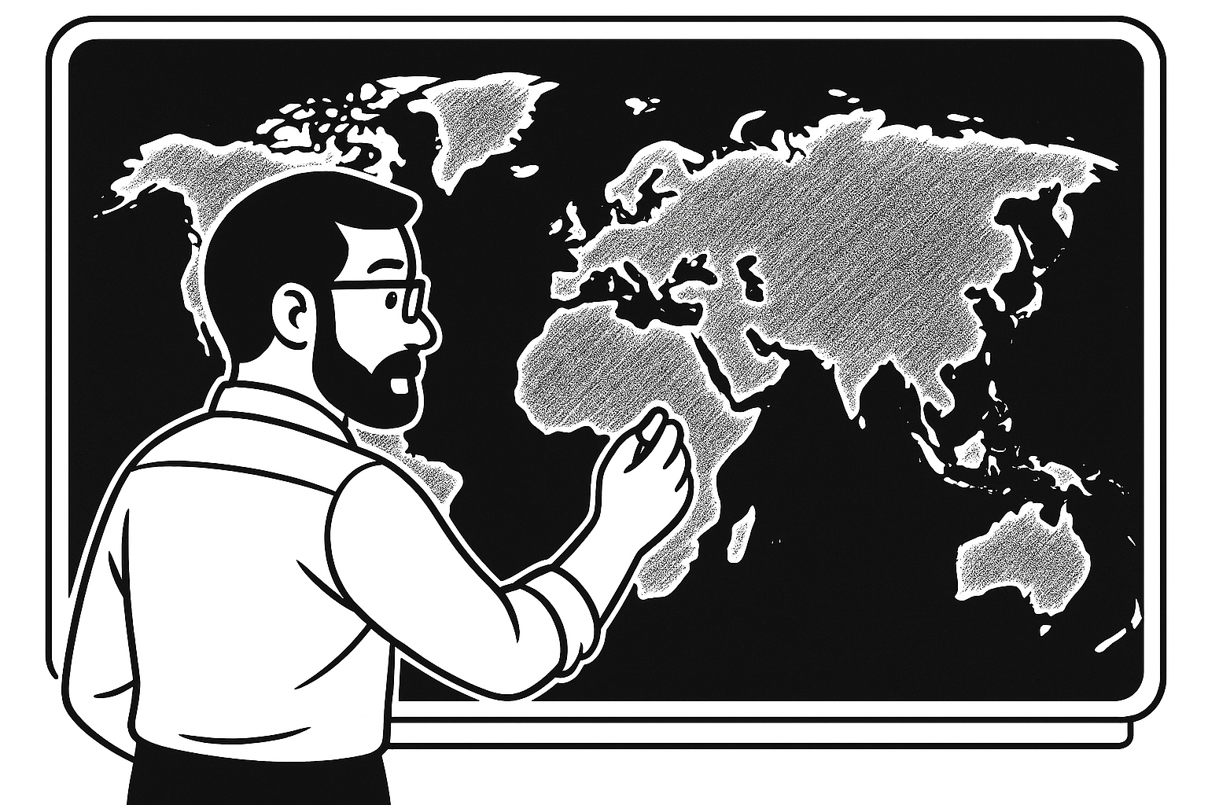
Navigating Blackboard
Announcements
Module documents – module handbook
Timetable
Reading List (regularly updated)
Teaching material is organised into separate course 1 & 2 folders
Lecture/seminar PowerPoint
You may be directed to reading materials or further study materials/resources
Assessment information
Glossary

Slide 16
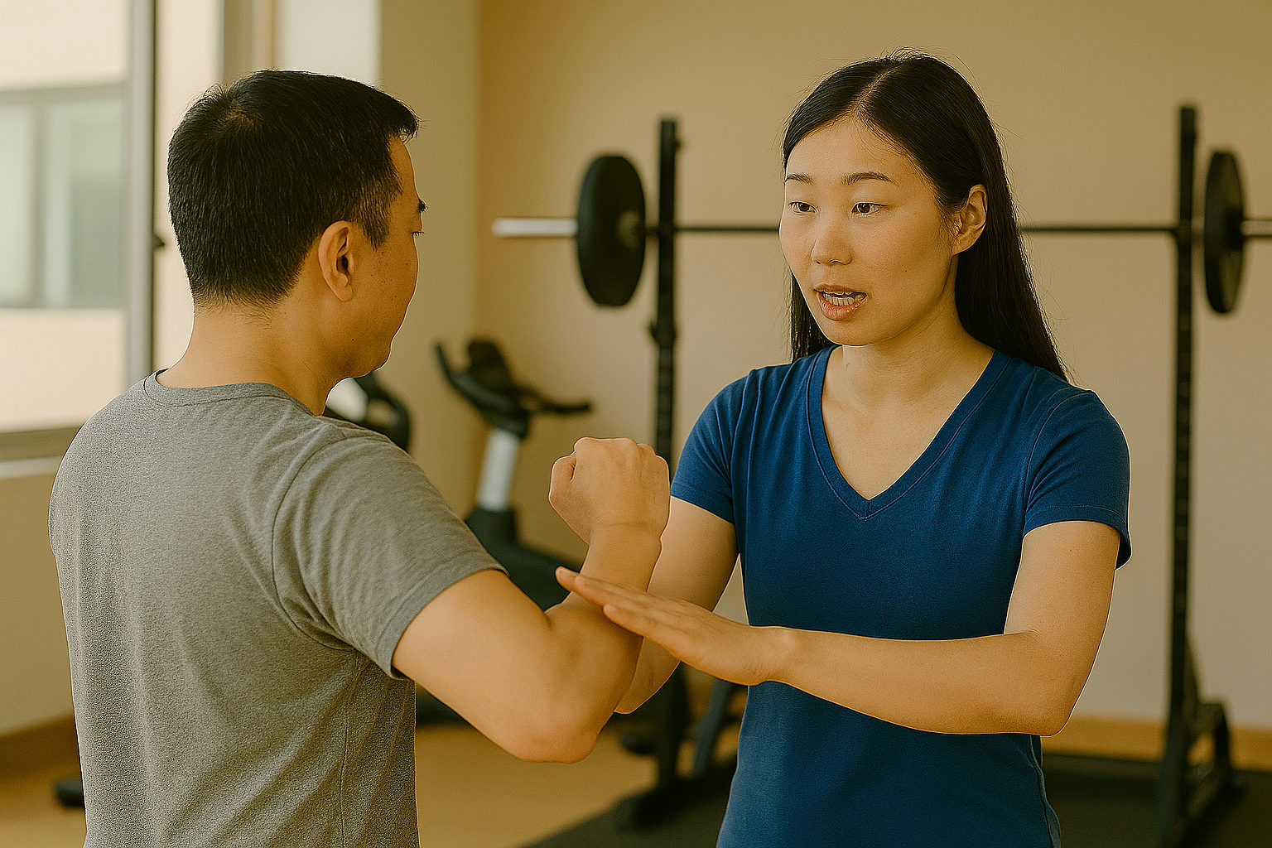
What do you hope to get out of this module?
Have a chat with the person next to you and then share with the group.

Slide 17

Any Questions

